Slide 1
Azure Cosmos DB

Slide 2
Azure Cosmos DB is a NoSQL Database as a Service provided by Azure.

Slide 3
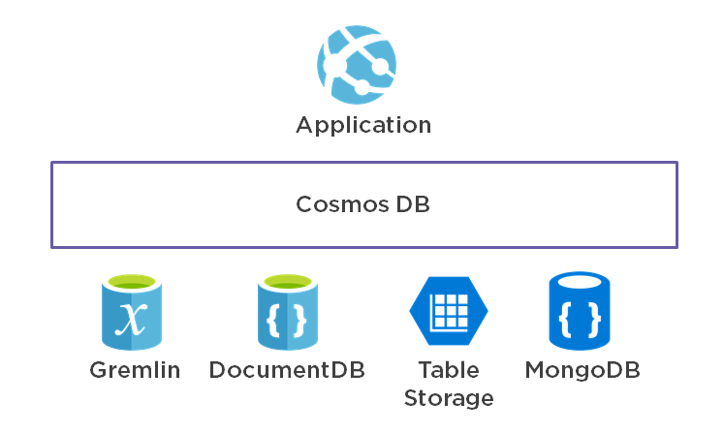

Slide 4
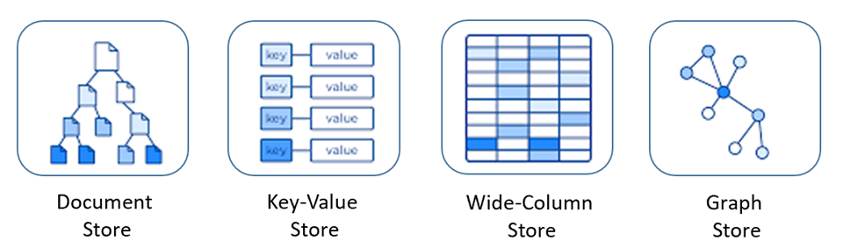
SQL API – Azure managed
Azure Table Storage – Key value based
MongoDb – Document based
Apache Cassandra – Column based
Gremlin – Graph Based

Slide 5
Any one of the 5 previous API need to be chosen while creating an Azure Cosmos DB App.
We can’t change from MongoDb back to Cassandra or vice-versa after app creation.

Slide 6
Azure Cosmos DB pricing
Request unit is a performance currency abstracting the system resources such as CPU, IOPS, and memory that are required to perform the database operations supported by Azure Cosmos DB.
The cost of every database operation in Cosmos DB is expressed using RUs.

Slide 7
Provisioned resources
Maximum RU(s) can be changed later.
E.g: If you set the max RUs to 10,000 and then down to 5,000 within the same hour, you will be charged 10,000 for the first hour and then continue to be charged for 5,000 RUs every hour after that until you change it again.
2 types of scaling –
Manual
Set max RU(s), if exceeded Azure Cosmos DB returns HTTP 429 too many requests.
Autoscale
Max RU(s) are added dynamically.

Slide 8
Serverless –
Only pay for how much RU(s) we consume.
Will scale up and down depending on load.
Size limit of 50gb.
Can run only on single region.

Slide 9
NoSQL why ?
Joins are resource expensive and cause locks.
Traditional RDBMS are hard to scale horizontally.
Weak in partition tolerance.
Needs structured data with proper schema defined which can be like double edged sword in some scenarios and useful in traditional web apps.

Slide 10
NoSQL characteristics
Database entities like tables don’t have fixed schema.
No concepts of Joins.
Data can be stored in unstructured fashion.
Relaxation on one or more of ACID properties.

Slide 11
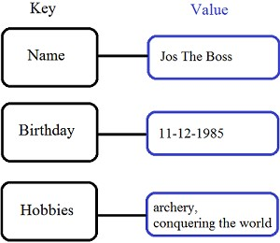
Types of NoSQL databases
Key Value databases –
Store data in a schema-less way.
Store data as hashtables/key-value pairs.

Slide 12
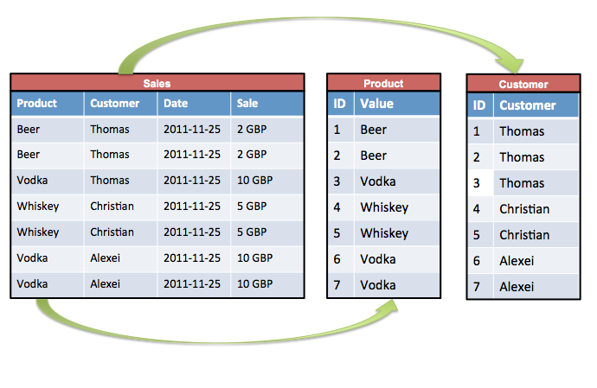
Column databases –
Data are stored in a column-oriented way
Columns are grouped in column-families
Data is stored by column families
Unit of data identified by “row-key”
Ordered and sorted based on “row-key”
Avoids consuming space for storing nulls

Slide 13
Document Database –
Data and metadata are stored hierarchically in JSON-based documents.
We can query documents by keys (fields).
Documents are considered whole and self-describing.
{
_id: ObjectId("51156a1e056d6f966f268f81"),
type: "Article",
author: "Derick Rethans",
title: "Introduction to Document Databases with MongoDB",
date: ISODate("2013-04-24T16:26:31.911Z"),
body: "This arti…"
}

Slide 14
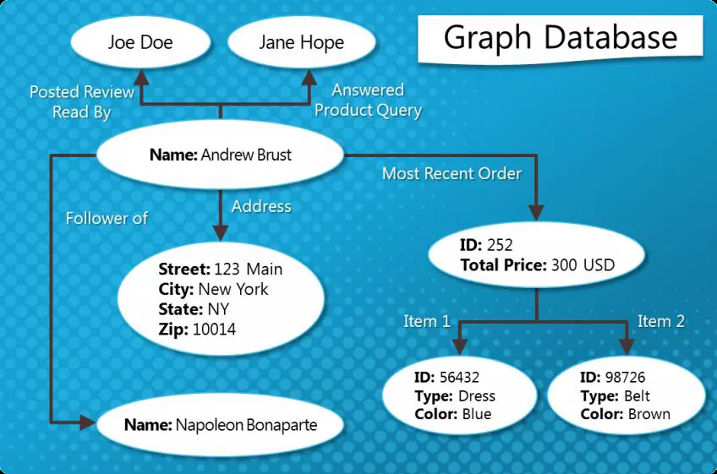
Graph Databases –
Data is stored in a graph data structure having node, edge, and attributes.
Each node and edge can have any number of attributes.
Both the nodes and edges can be labelled.
Labels can be used to narrow searches.

Slide 15
MongoDb features
Popular NoSQL document database.
Stores data in JSON-like binary format called BSON.
Supports in-built replication with Replica set model.
Supports sharding natively.
Supports all 4 ACID properties starting from MongoDB v4.0+
Supports indexing like a traditional RDBMS.
Available in versions 3.2, 3.6, 4.0 and 4.2 in Azure Cosmos DB

Slide 16
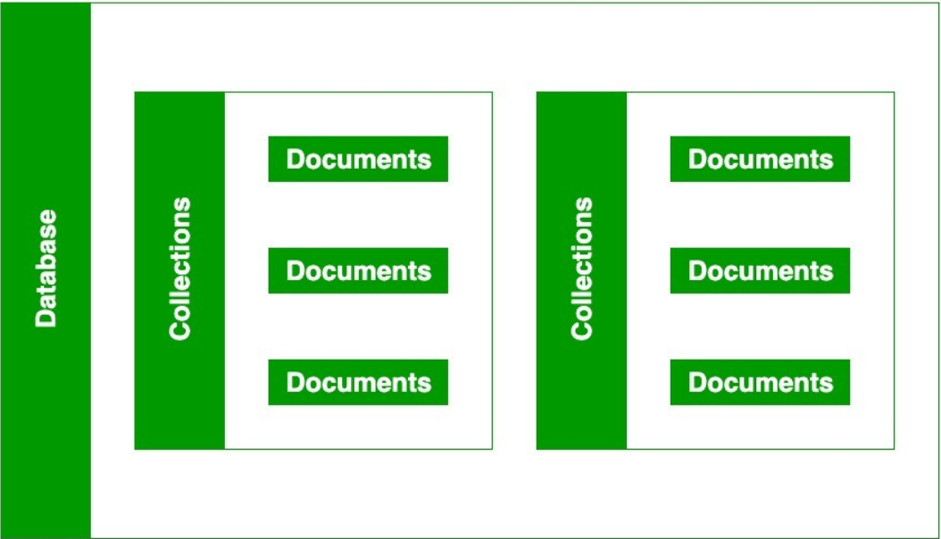
MongoDB structure

Slide 17
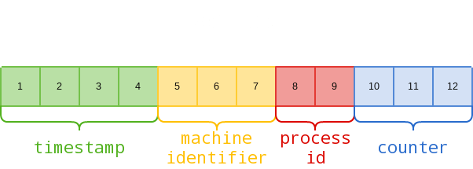
MongoDb ObjectId
Special id to keep track of documents.
Indexed automatically.
{
"timestamp": 1646771722,
"machine": 16603232,
"pid": 23650,
"increment": 10829842,
"creationTime": "2022-03-08T20:35:22Z"
}

Slide 18
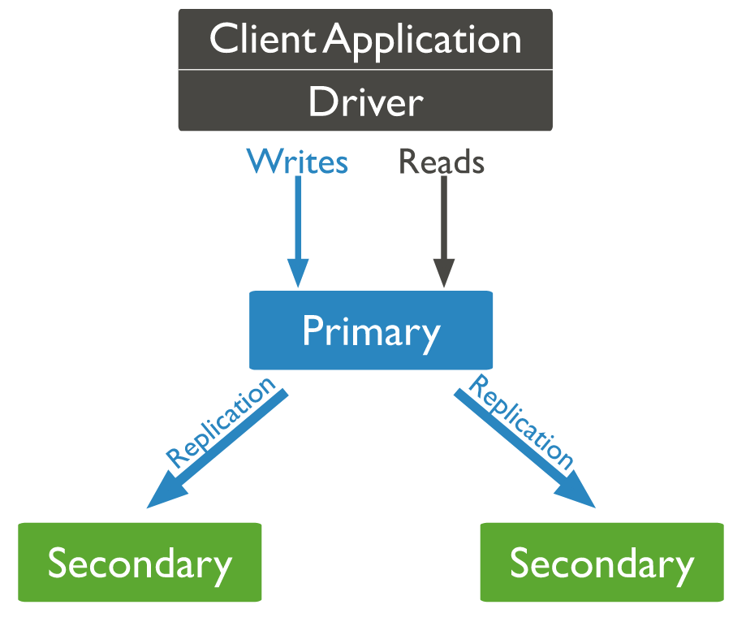
MongoDb replica set model

Slide 19
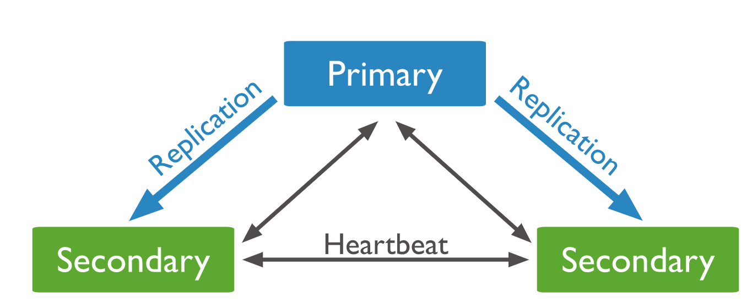
MongoDb Replica Set communication

Slide 20
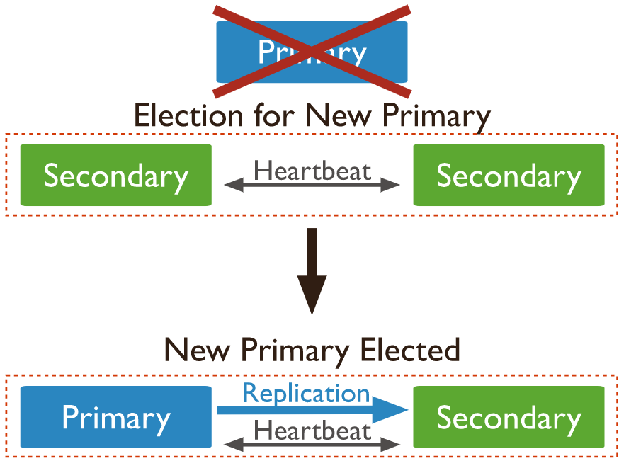
MongoDb Failover mechanism

Slide 21
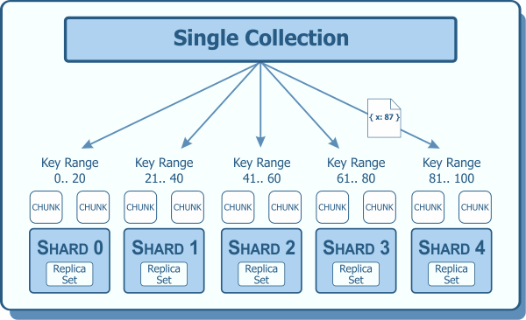
MongoDb sharding model

Slide 22
CRUD API(s)
Create
db.collection.insertOne({ });
db.collection.insertMany([ {}, {}, {} ]);
Read
db.collection.find({}, {})
db.collection.findOne({}, {})
Update
db.collection.updateOne({<filter>}, {<set>})
db.collection.updateMany({}, {})
Delete
db.collection.deleteOne({})
db.collection.deleteMany({})

Slide 23
Robo3T
Popular open source MongoDb query editor.
Download https://github.com/Studio3T/robomongo/releases/download/v1.4.4/robo3t-1.4.4-windows-x86_64-e6ac9ec5.exe
Connect an Azure Cosmos Db Mongo Db database using Robo3T – https://docs.microsoft.com/en-us/azure/cosmos-db/mongodb/connect-using-robomongo

Slide 24
Demo

